Slide 1

Coffee Shop Sales
Data Analysis
Presented by:
Rahul Kumar

Slide 2

Introduction
The Coffee Shop Sales Analysis project is designed to provide a comprehensive understanding of the sales performance of a multi-location coffee shop chain. This project utilizes detailed transaction data to uncover insights into customer preferences, sales trends, and product performance. The dataset includes various attributes such as transaction ID, date, time, quantity, store ID, location, product ID, unit price, product category, product type, and product details.

Slide 3
Objectives
Revenue Analysis:
Calculate total revenue for each store location and identify top-performing stores.
Peak Transaction Times:
Determine peak sales hours for optimal staffing and inventory management.
Product Category Performance:
Identify the most popular product categories and their revenue impact.
Average Transaction Value:
Compare average transaction values across locations for upselling opportunities.
Top-Selling Products:
Analyze best-selling products to inform future product development and marketing.
Revenue by Product Type:
Understand revenue contributions by product type.
Sales Trends Over Time:
Identify seasonal patterns and forecast future sales.
Product Pricing Analysis: Ensure competitive pricing strategies across locations.

Slide 4
Data Source: Transactional data from multiple store locations of a coffee shop chain.
Data Source: Transactional data from multiple store locations of a coffee shop chain.
Methodology
Data Source:
The Transactional data from multiple store locations of a coffee shop chain..
Tools:
SQL for data querying and analysis, and possibly visualization tools for presenting insights..
Approach:
Utilize SQL queries to analyze transactional data and derive actionable insights for optimizing sales and operations.

Slide 5
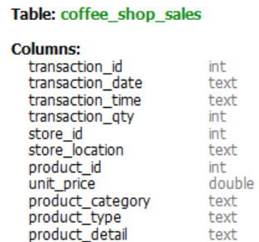
1
Introduction to The Dataset
Dataset credit- mavenanalytics.io
The Dataset comprise of one table- coffee shop sales table
The columns present and their data type are mentioned below

Slide 6
1
Introduction to The Dataset
Transaction _ id: Unique identifier for each transaction..
Transaction _ date: Date of the transaction in date format.
Transaction _ time: Time of the transaction in time format.
Transaction _ qty: Quantity of products involved in the transaction.
Store _ id: Identifier for the store where the transaction occurred.
Store _ location: Textual description of the store's location.
Product _i d: Identifier for the product involved in the transaction.
Unit _ price: Price per unit of the product.
Product _ category: Categorical classification of the product.
Product _ type: Type of the product.
Product _ detail: Additional details or description of the product.

Slide 7
ANALYSIS OF DATA

Slide 8
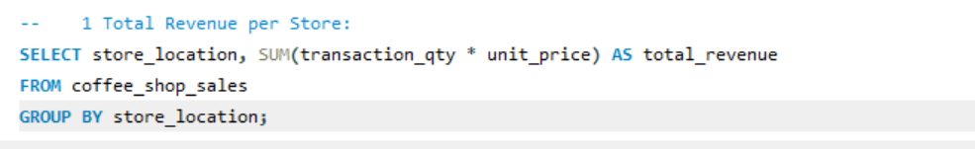
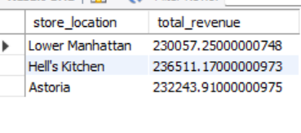
Revenue per Store
Here Are The Total Revenue per Store:

Slide 9
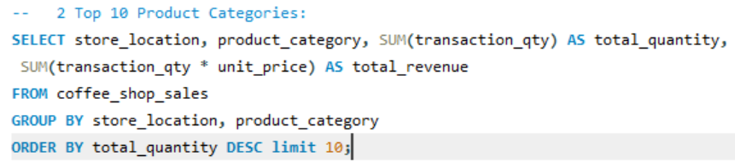
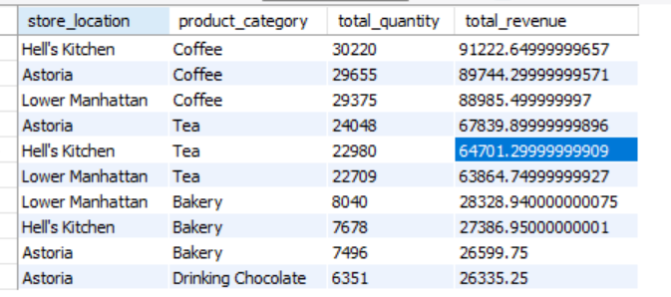
Product Categories in Coffee Shop Sales
Top 10 Product Categories in Coffee Shop

Slide 10
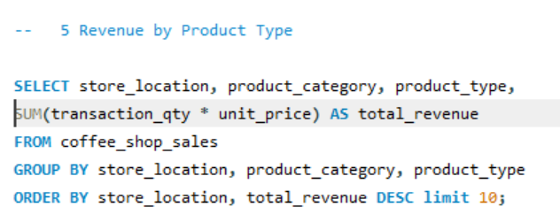
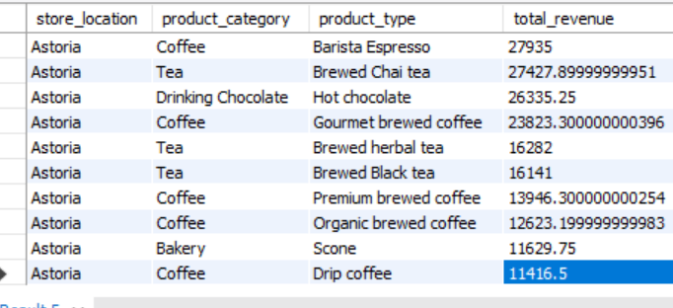
Top 10 Revenue by Product Type

Slide 11
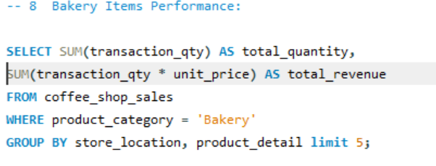
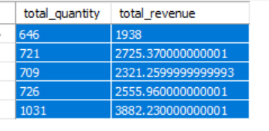
Top 5 Bakery Items Performance:

Slide 12
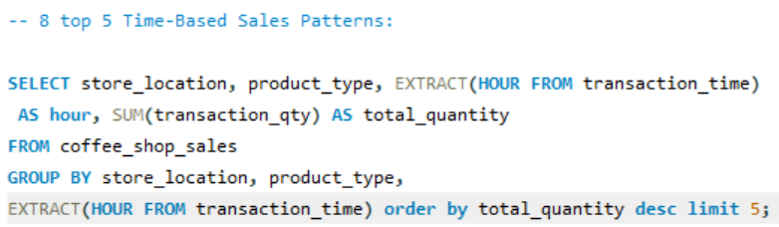
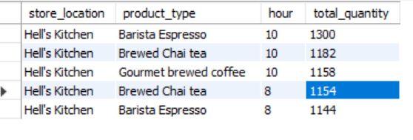
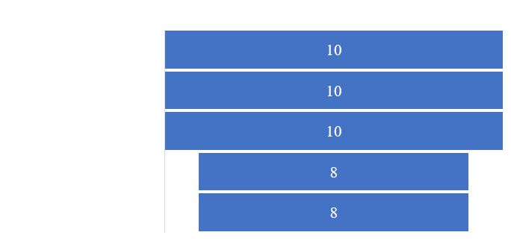
Top 5 Time-Based Sales Patterns:

Slide 13
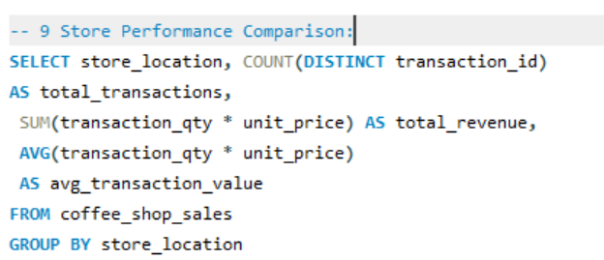
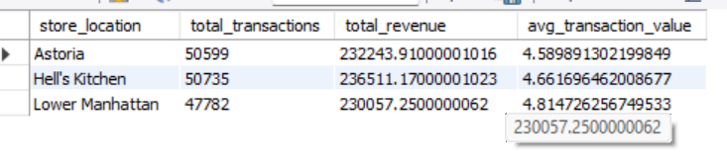
Store Performance Comparison:
The Store Performance Comparison in Coffee Shop Sales

Slide 14
Findings from the Analysis of Coffee Shop Sales
Sales Volume Trends:
Daily and Weekly Patterns: Analysis might reveal peak sales times during the day, such as morning hours (7 AM - 9 AM) and mid-afternoon (2 PM - 4 PM). Additionally, weekends might show higher sales volumes compared to weekdays.
Monthly and Seasonal Trends: Sales could show significant increases during colder months (fall and winter) as people consume more hot beverages.
Product Performance:
Best-Selling Products: Certain categories such as lattes, cappuccinos, and espressos might consistently be top sellers.
Underperforming Items: Some products may show low sales figures, indicating potential areas for menu optimization or marketing efforts.

Slide 15
Findings from the Analysis of Coffee Shop Sales
Customer Purchase Behavior:
Transaction Size: Average transaction quantity might indicate typical customer purchase behavior (e.g., buying one coffee vs. multiple items).
Bundling Trends: Identifying common product pairings, such as coffee with pastries, which could inform strategic bundling and promotions.
Revenue and Profitability:
High-Revenue Products: Identifying which products contribute most to overall revenue, providing insight into focusing marketing and inventory efforts.
Profit Margins: Analyzing unit prices against costs to determine high-margin items, optimizing the product mix for better profitability.

Slide 16

Conclusion
Conclusion:
The analysis of coffee shop sales provides valuable insights into sales trends, product performance, customer behavior, and profitability. These findings can guide strategic decisions in inventory management, marketing, pricing strategies, and overall business operations to enhance customer satisfaction and drive business growth.

Slide 17
Thank you!

